Slide 1
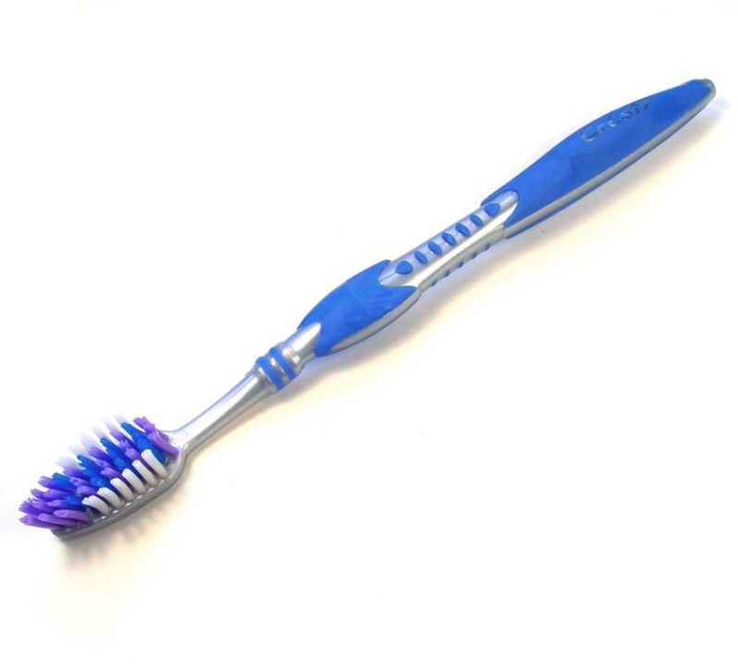
Everything around us has been designed!
Notes:
Everything we see and touch was made by a designer for specific functions and users. But what do these things mean?
Design
To make an object that solves a problem
Designer
A person who creates a new object, idea, or plan
Design Solution
The way, idea, or answer to a design challenge or problem
Function
The way something works, or a purpose of an object
e.g., the function of a paper clip is to fasten things together
User
A person who operates or experiences the design
Survival
Staying alive, especially in the face of challenging conditions

Slide 2
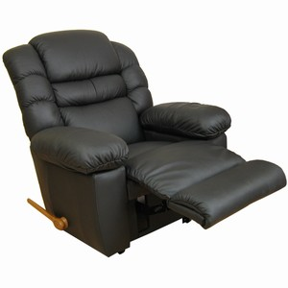
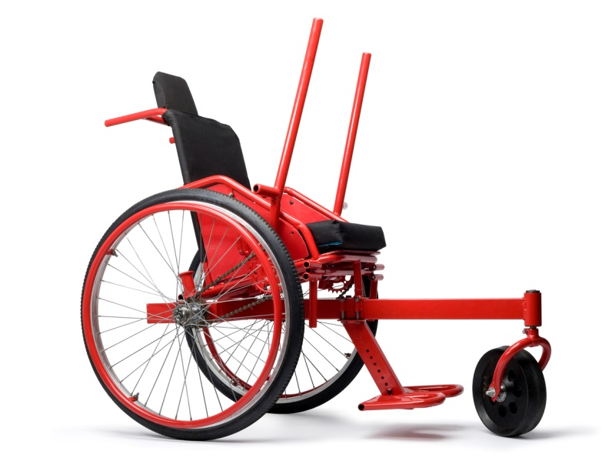
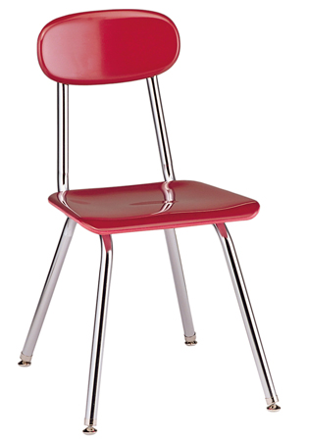
Designers think about what the user needs.
Notes:
Materials
The items you are using to represent your ideas; what something is made with
Form
The shape and structure of an object
Needs
What the user must have in order to use the design successfully
Ergonomics
The design and arrangement of things people use in a way that emphasizes efficiency, safety, and comfort
Design Solution
The way, idea, or answer to a problem. There can be more than one
Who is the user for each of these chairs?
What are their needs?
What were the designers’ solutions to those needs?
How does the material meet these needs?
How does their form meet these needs?
Some answers:
Chair 1: Students who sit in them (the size needs to be correct and since they are in them all day they need to be fairly comfortable
The administrator who purchases them is a user, and that person has needs defined by a budget.
Custodians who clean them and move them need them to be wipable and stackable.
Chair 2:
The user is most likely an adult
Their needs: comfort (cushioning, reclining, leg support), convenience (the handle to let out the leg support)
Chair 3:
Somebody who is unable to walk who needs to go over rough terrain
Needs are mobility, comfort, and the ability to travel without a helper

Slide 3
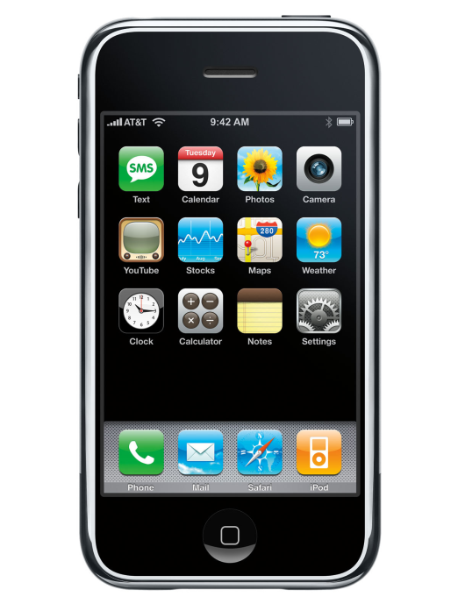
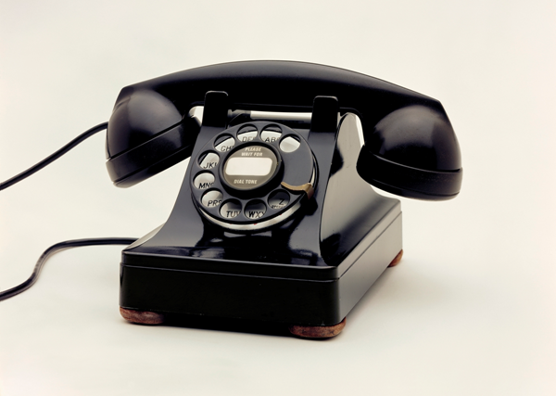
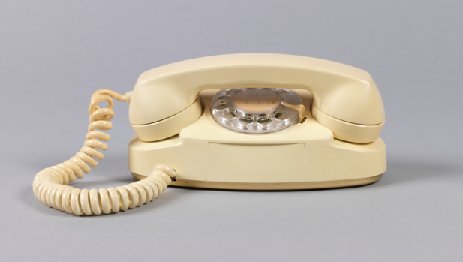
There are lots of ways to address the same need.
Notes:
System
A group of related parts that work together
User-centered design
An approach to design that considers the needs of the user throughout the design process
Who are the users for each of these objects? What are their needs?
What were the designers’ solutions to those needs?
How is the MetroCard a tool? How is it a part of a system?

Slide 4
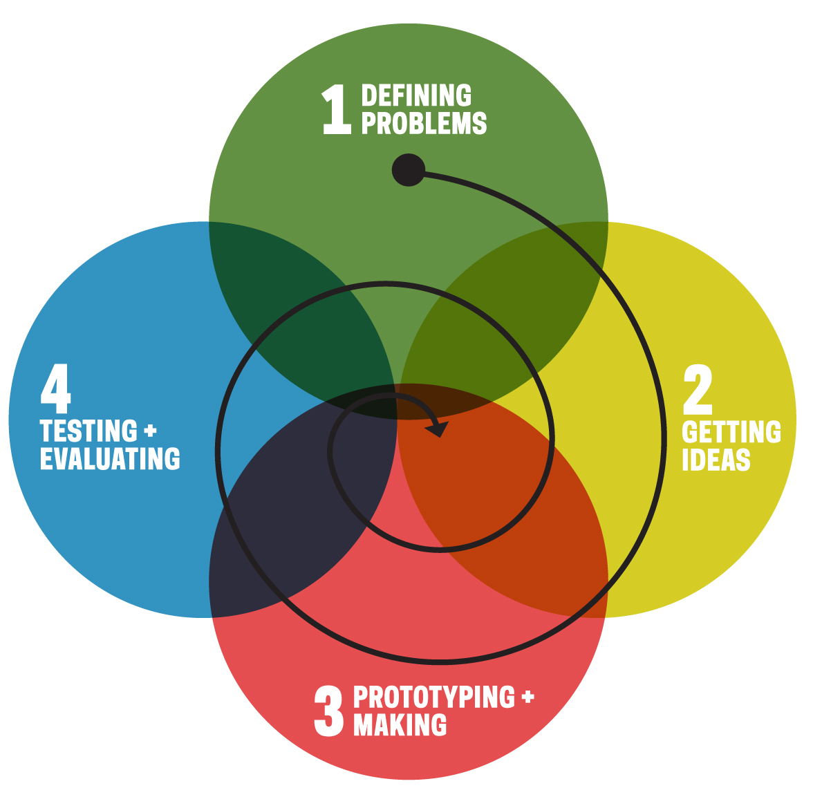
Notes:
The design process is the steps that one takes to solve a challenge. There are four basic stages, but you might not always go in the same order and there is no end to this process. It is a cycle that can always be repeated:
1. Defining problems
2. Gettting ideas
3. Prototyping and making
Prototype
An original model on which something is patterned
4. Testing and evaluating

Slide 5
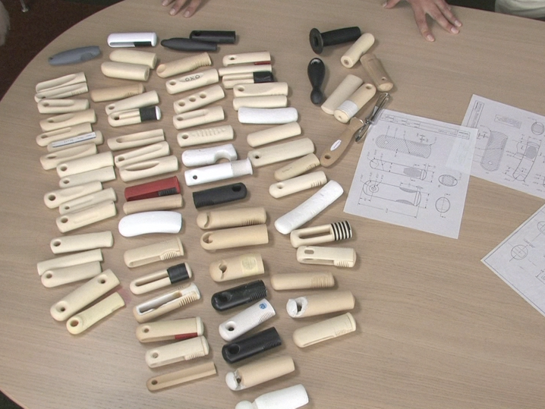
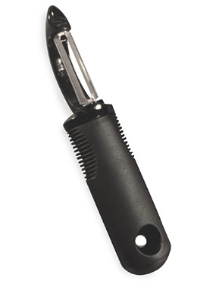
Designers make lots of prototypes to help find the best solution.
Notes:
Here is a snapshot of the prototyping phase in the design of this potato peeler. This object was made in response to users that were having difficulties with the older metal version. The designer is responding with empathy to that user, and their design challenge is to make a peeler that is comfortable for them to hold and operate. On the table you can also see drawings that might be submitted for a patent.
Empathy
To vicariously experience what another person is feeling without being in the same situation as them
Design Challenge
A difficulty or challenge that can be solved through design
Patent
A document granting ownership of the design of a product
When we go to the museum, the objects we see will be primary sources about design, including prototypes, drawings, and final products.
Primary source
Original material with a direct connection to the period or topic of study

