Slide 1

2019 NATIONAL HIGH SCHOOL DESIGN COMPETITION
LESSON 2: NATURE-BASED DESIGN

Slide 2
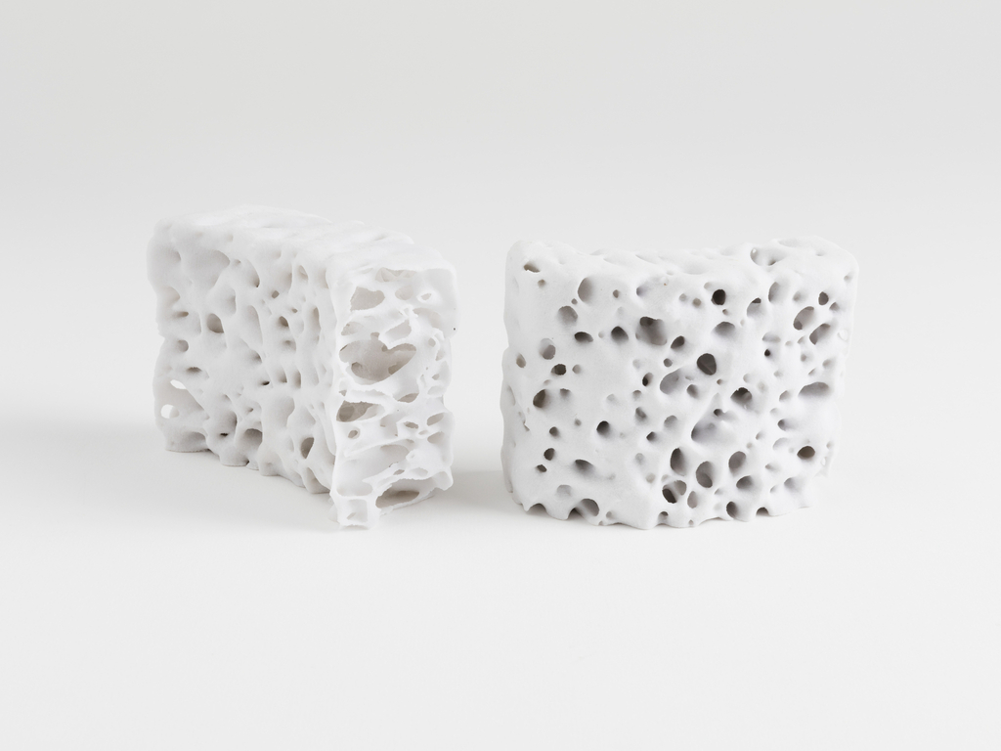
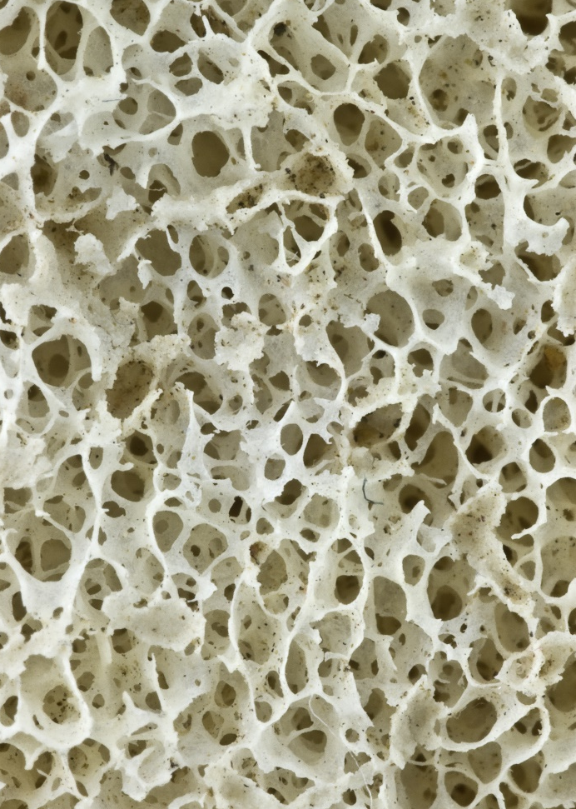
ZOOM IN
Notes:
ZOOM IN
Dissect the properties, elements, structure, and/or functions of a particular part of nature to implement in alternative uses.
What are the individual components and what are their properties?
What is unique or noteworthy about one or more of the specific components?
What is happening on a material or molecular level that supports this part of nature?
The Polybrick series (pictured) borrows inspiration from the microscopic structure of bones (image right) to create a ceramic building material that is 3D printed. This structure allows the material to be very strong but lightweight and conserves material while also reducing waste.
Source:
PROTOTYPE, POLYBRICK SERIES, 2014
Short URL http://cprhw.tt/o/77CvP/
Accession Number 35.2015.3a,b
Object ID 69192481
NMNH - Anthropology Dept.Site NamePecan PointDonor NameBureau Of American EthnologyCollectorDr. Edward Palmer
Accession Number:
014255U
SNM NumberA63047-0

Slide 3
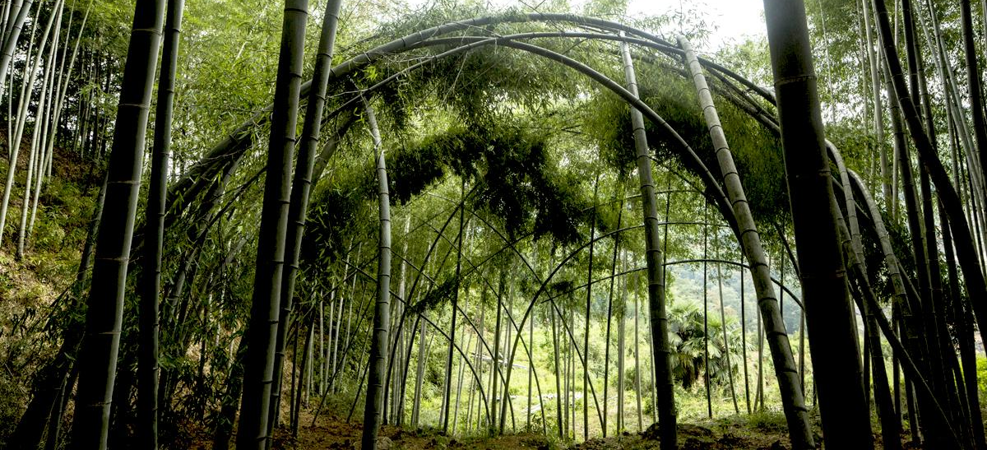
ZOOM OUT
Notes:
ZOOM OUT
Design with the entire location or ecosystem in mind, thinking about the various components and how they will interact or affect one another.
How many different elements or organisms compose this location or ecosystem?
What are the threats or challenges to sustaining the location or ecosystem?
What are the positive effects or features of this location or ecosystem?
BABMOO THEATER
This Bamboo Theater is a living structure composed of bent Mao Zhu bamboo planted around an open court. The roots of the bamboo spread horizontally underground and serve as the foundation of the theater and the flexible and fast growing stalks are woven together to create a dome under which performances and gatherings can take place.
Bamboo Theater, Xu Tiantian

Slide 4
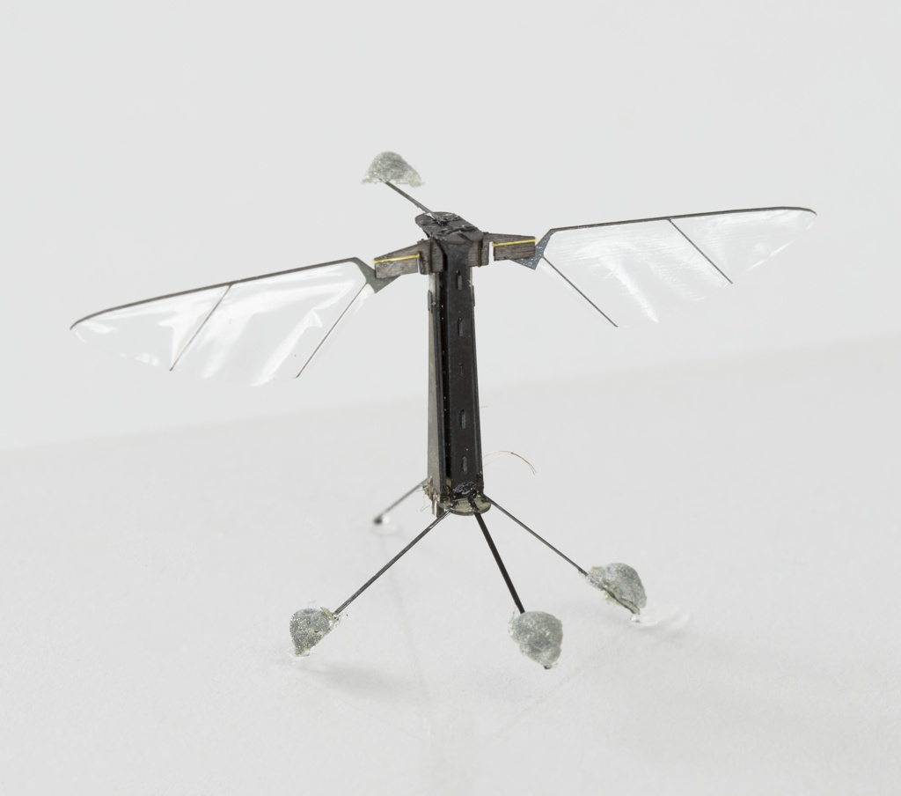
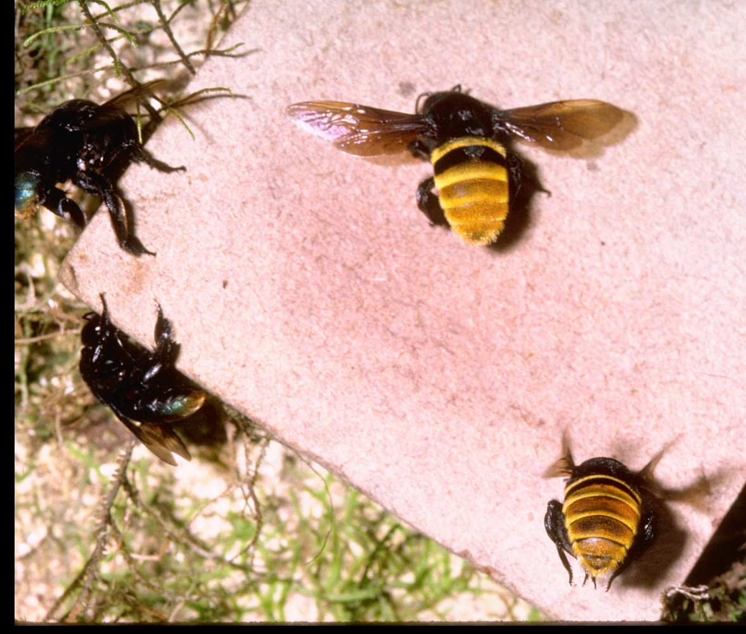
MIMIC ACTIONS
Notes:
MIMIC ACTIONS
Apply the systems, patterns, behaviors, and networks of the natural world to inform your design.
What are the cycles or steps? How do they transition from one to another?
What are the various components or factors and how do they communicate, interact, or work together?
What are the results or positive outcomes?
ROBOBEE
RoboBee is a small robot inspired by the behavior of bees, small insects who work together as a hive to accomplish large tasks. Swarms of RoboBees could have the capacity to pollinate crops, conduct search-and-rescue missions, act as environmental sensors, or conduct covert surveillance.
Video Resource: https://youtu.be/hEZ7rHRifVc
ROBOBEE (USA), AUGUST 2012
Short URL http://cprhw.tt/o/5xWrv/
Accession Number 2015-23-1
Object ID 51497591
Bee: SIA Acc. 11-009 - Smithsonian Institution. Smithsonian Photographic Services, Photographic Collection, 1971-2006, Smithsonian Institution ArchivesRepository Loc.Smithsonian Institution Archives Capital Gallery, Suite 3000, MRC 507; 600 Maryland Avenue, SW; Washington, DC 20024-2520

Slide 5
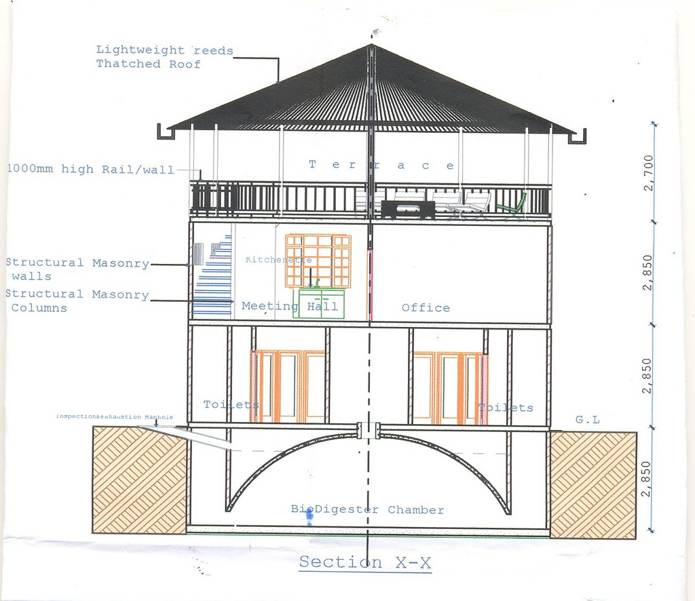
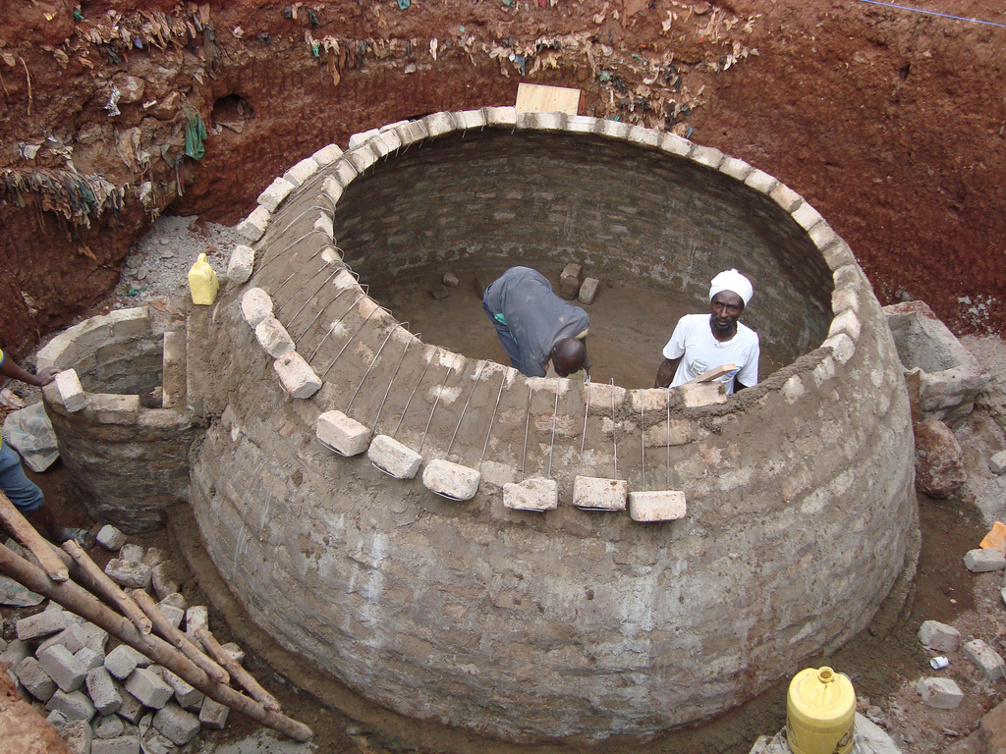
USE EVERYTHING
Notes:
USE EVERYTHING
Consider all the elements or materials involved in a process and how you might use everything, leaving no waste or leftovers.
Trace the system or process from the very beginning to the end and consider all the individual inputs and outputs.
What raw materials or waste materials might be reused or redirected positively? What elements might need to removed entirely to create a positive effect?
How might nature be incorporated in the process? What positive outputs or outcomes might be produced from the process?
BIOCENTRE
In the slums and informal settlements of Nairobi, there is only one latrine for every 150 people, leading to pollution and diseases. Kenya-based Umande Trust worked with residents and artisans in the slums of Nairobi and Kisumu to design the BioCentres. Built from locally available technology and materials, the multi-story BioCentres uses anaerobic—or airless—digestion, in which bacteria transforms human waste into fertilizer and methane-based gas for cooking and heating water, reducing carbon emissions. A shallow pit latrine feeds into a domed underground bio-digester and expansion chambers, which need little maintenance since there are no moving parts. Generated bio-gas and liquid fertilizer can be sold for income.
BIOCENTRE, 2006–2011
Short URL http://cprhw.tt/o/DbAUF/
Accession Number CITIES.009
Object ID 420778903

Slide 6
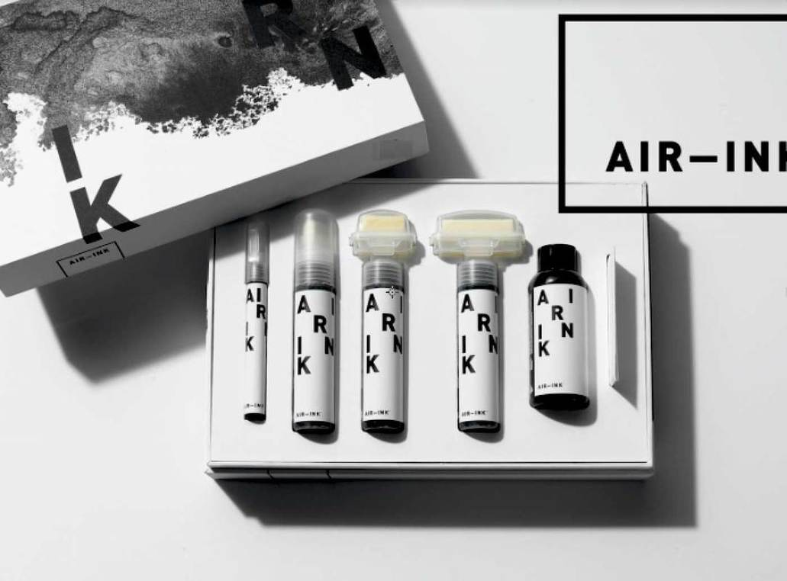
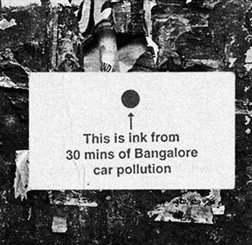
REVERSE COURSE
Notes:
REVERSE COURSE
Intervene in a harmful process or system to create a positive impact on nature.
Trace the system or process from the very beginning to the end and consider all the individual agents or elements involved.
Where is nature incorporated or impacted and in what capacity?
What elements might need to removed or redirected to create a positive effect?
AIR-INK
Air-Ink uses special filters to capture particles from exhaust sources such as buildings and vehicles before they can be released into the atmosphere and the captured particles are reused to create ink for markers.
Air Ink, Graviky Labs
Insert yourself into the chain of environmental impact to mitigate, disrupt negative patterns

Slide 7
Activity: Design TActics Matrix
Broaden appreciating and understanding of “nature.”
Learn tactics from successful design projects and apply those tactics to new nature-based opportunities.
Use the “Design Tactics Matrix” to build a bank of nature-based resources and ideas.

Slide 8
Watch: The Matrix Method
Learn how to use a matrix to push your brainstorming practice and develop unexpected solutions.

Slide 9


