Slide 1
2019 NATIONAL HIGH SCHOOL DESIGN COMPETITION LESSON 1: WHAT IS DESIGN?
Notes:
Using the “What is Design?” presentation to introduce students to the concept of design and explore the design process through a case study, facilitate conversation regarding the ways the steps of the design process support each other and how each step might happen multiple times within a project.

Slide 2
What is design?
Notes:
Ask the class what they think of when you hear the word “design?”

Slide 3
What is design?
Design is all around us.
Design is problem solving.
Design can address big challenges with simple solutions.
Design has a user in mind.
Design can be a system or experience, not just an object.
Design is a process.
Notes:
Design is more than the product or end result; design is the process that creates the end result.

Slide 4
Design is all around us
Notes:
Consider what you’re wearing today, what features does it include? How was it designed to make wearing it more comfortable or functional?
What objects did you use this morning to get ready for school? Consider your toothbrush or toothpaste tube and how they were designed to be efficient or if there are simple ways they could be improved.
Consider all the screens and pieces of technology we utilize each day and how the object has been designed for us to hold and carry. Also think about the icons and interactions that have been designed to make the system easy to use (such as the home button, settings, menus, etc.)
Sources:
JACKET, ADAPTIVE PUFFER JACKET, 2017
https://collection.cooperhewitt.org/objects/1158831757/
0803, HEWI DOOR HARDWARE AND BATHROOM FIXTURES
https://collection.cooperhewitt.org/objects/1159162343/
IPAD 2 TABLET COMPUTER, 2011
https://collection.cooperhewitt.org/objects/18797369/

Slide 5
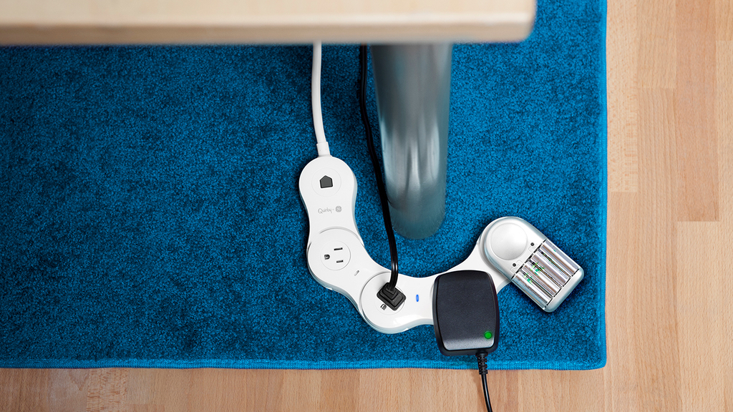
Design is problem solving
Notes:
Design is problem solving, like having a hard time getting an outlet where you need it, or running out of room to plug in your phone. How might we access our outlets more efficiently? Consider challenges that you may have had in finding a place to charge your phone or fitting all of your electronics into your outlet or power strip. These are some of the design solutions that were developed to address these everyday problems.
Sources:
SURGE PROTECTOR, PIVOT POWER GENIUS FLEXIBLE, 2013
https://collection.cooperhewitt.org/objects/68250889/
EXTENSION CORD, PROP POWER WRAP-AROUND, 2013
https://collection.cooperhewitt.org/objects/68775091/

Slide 6
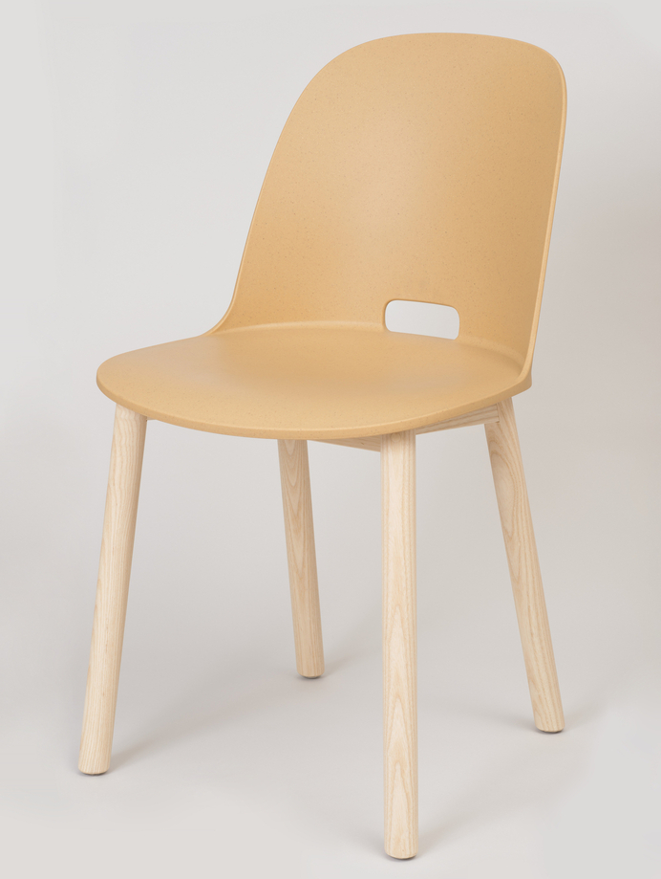
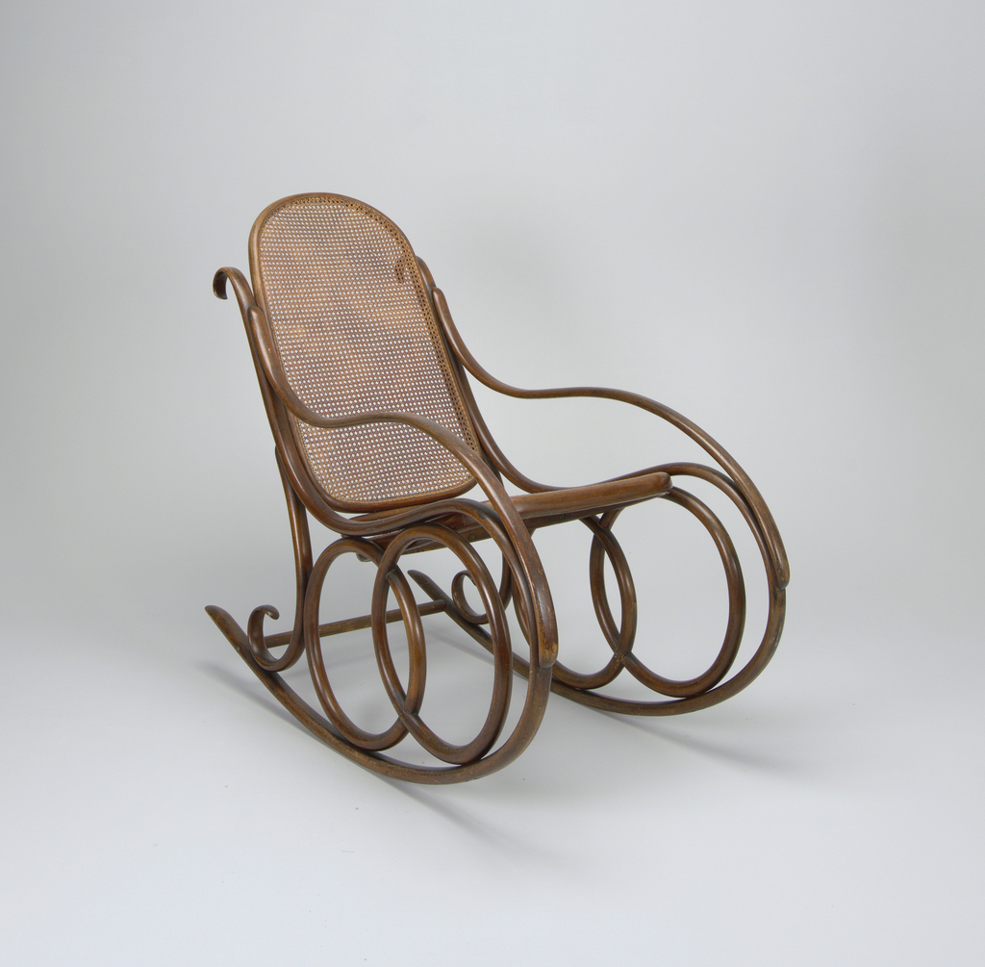
Design has a user in Mind
Notes:
Who might you assume is the intended user or environment for each of these chairs? Even though these objects all have the same function, how is the design different based on the user?
Can you identify a feature or function unique to only one of the designs? What does that feature or function tell you about the intended use or user?
Sources:
AERON OFFICE CHAIR, 1992
https://collection.cooperhewitt.org/objects/18655575/
ALFI HIGH BACK CHAIR, 2015
https://collection.cooperhewitt.org/objects/69187403/
NO. 4 ROCKING CHAIR, CA. 1860
https://collection.cooperhewitt.org/objects/18467803/

Slide 7
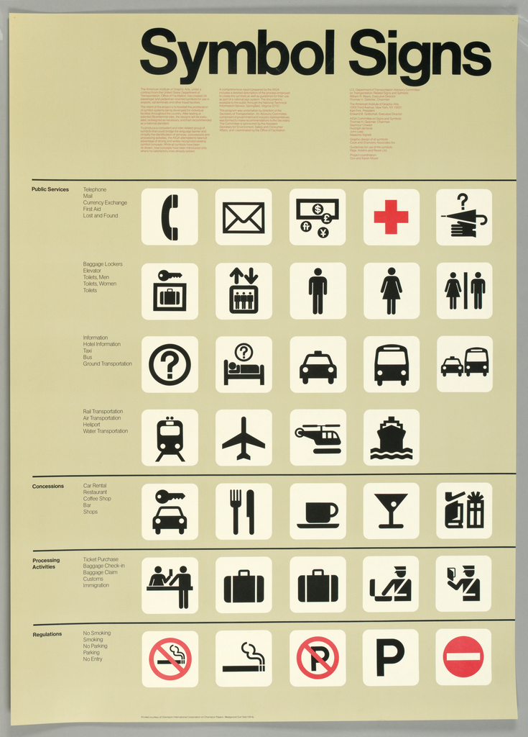
Design Can be A system or experience
Notes:
We may overlook design because we have become so familiar with the experience. Ask students how many of these graphics they can recognize and what they mean.
This system of icons allows ideas to be easily communicated without language. If time allows, ask students to consider what icon they would add to this list, and how it would be represented.
Sources:
POSTER, SYMBOL SIGNS, 1974
https://collection.cooperhewitt.org/objects/18673291/

Slide 8
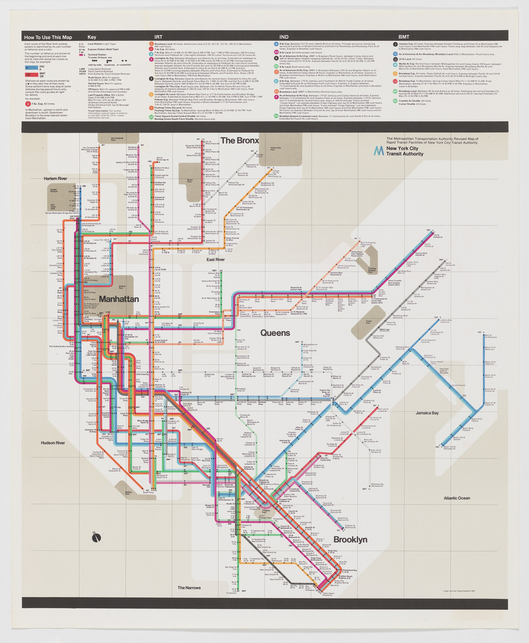
Design can address Big challenges with simple solutions
Notes:
The challenge of navigating a complex system like the New York City subway is just one everyday task made simpler by design. Using a different color for each subway line made the complex subway map easier to navigate and utilize so users could distinguish at a glance where each track would lead them and follow their chosen route. Can students think of other ways color has been utilized to quickly convey information?
Sources:
POSTER, NEW YORK CITY SUBWAY MAP, 1974
https://collection.cooperhewitt.org/objects/18622259/

Slide 9
DESIGN IS A PROCESS
FRAME THE CHALLENGE
BRING IDEAS TO LIFE
SHARE WITH USERS
UNDERSTAND THE CHALLENGE
DIVERGE AND CONVERGE
LEARN AND REFINE
Notes:
The design process can be visualized into several steps. While they are depicted in a linear fashion, the process is often cyclical, returning to the same step multiple times before reaching a satisfactory conclusion.
Each step has a particular function and allows designers to efficiently progress from large challenges to actionable solutions. We will use an example of a project to demonstrate how the design process might look in action.

Slide 10
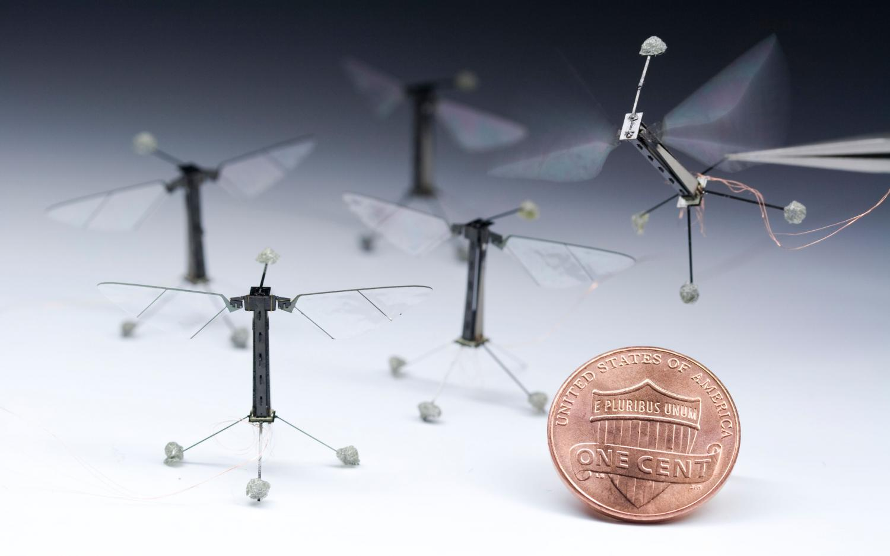
DESIGN CASE STUDY
ROBOBEE (USA) AUGUST 2012
Notes:
Objectives:
Gain familiarity with the design process
Understand what the steps of the design process might look like in application
Connect design objects to the design process

Slide 11
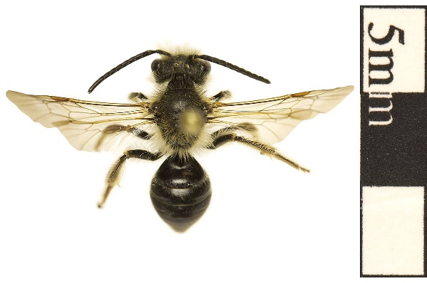
Notes:
In order to address their challenge, the designers looked closely at bees and bee colonies to understand the ways that they behave and interact with each other and the environment, including how they pollinate crops.
The RoboBee was designed by researchers at Harvard University’s School of Engineering and Applied Sciences as a response to this challenge.
Strategic mindset
Identify the problem
Frame the problem
Adjust scope
Identify stakeholders
Source:
Bee NMNH - Education & Outreach, Smithsonian Institution. “Smithsonian Learning Lab Resource: Bee.” Smithsonian Learning Lab, Smithsonian Center for Learning and Digital Access, 5 Oct. 2018. learninglab.si.edu/q/r/3210023. Accessed 20 Nov. 2018.

Slide 12
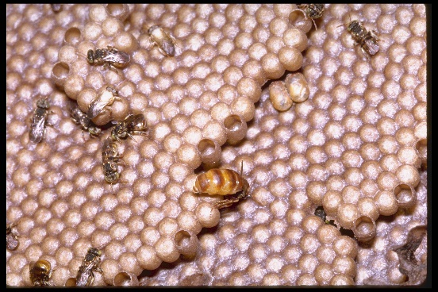
Notes:
After many observations and brainstorming sessions, the designers decided to base their solution on real bees in three ways: body, brain, and colonies. They wanted the bees to be able to interact with each other so they can work as a single swarm, coordinating their behavior to accomplish large tasks.
“For us, bees are something of a metaphor,” said the designers, “They are social insects; they interact with the environment and with each other in ways that make the whole greater than the sum of the parts.”
Inquisitive mindset
Understand the user
Learn from all stakeholders
Map different viewpoints
Challenge assumptions
Source:
Bee Hive, Panama. Smithsonian Institution Archives, Smithsonian Institution. “Smithsonian Learning Lab Resource: Bees, Panama, STRI.” Smithsonian Learning Lab, Smithsonian Center for Learning and Digital Access, 3 Mar. 2016. learninglab.si.edu/q/r/911362. Accessed 20 Nov. 2018.

Slide 13
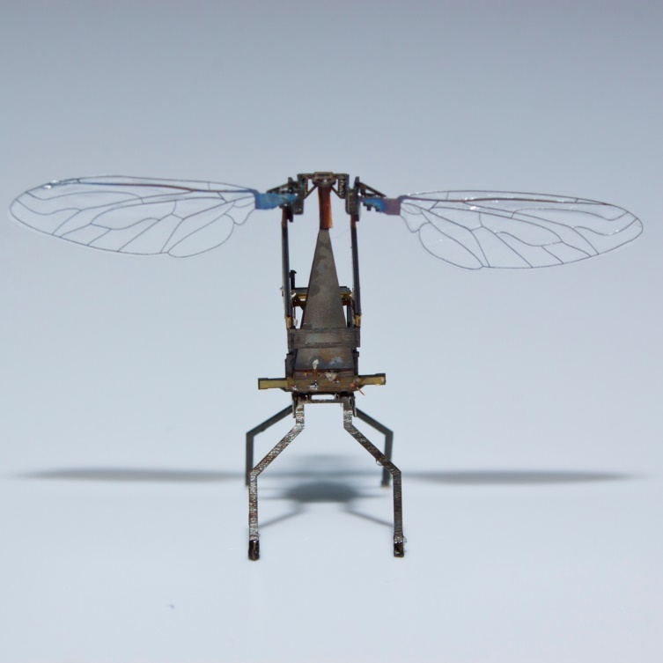
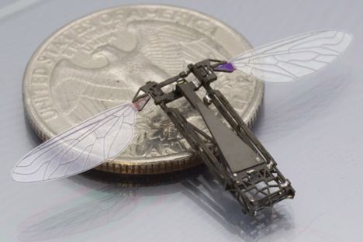
Notes:
After many observations and brainstorming sessions, the designers decided to base their solution on real bees in three ways: body, brain, and colonies. They wanted the bees to be able to interact with each other so they can work as a single swarm, coordinating their behavior to accomplish large tasks.
Prolific mindset
Defer judgement and encourage wild ideas
Record all ideas and be visual
Stay on topic and build on the ideas of others
Strive for quantity
Source:
ROBOBEE, 2012
Short URL http://cprhw.tt/o/5xWrv/
Accession Number 2015-23-1
Object ID 51497591

Slide 14
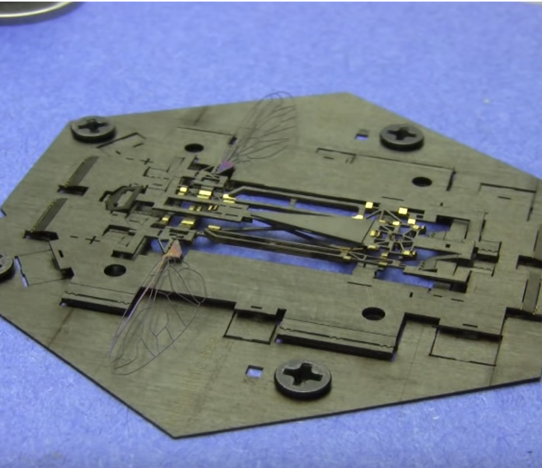
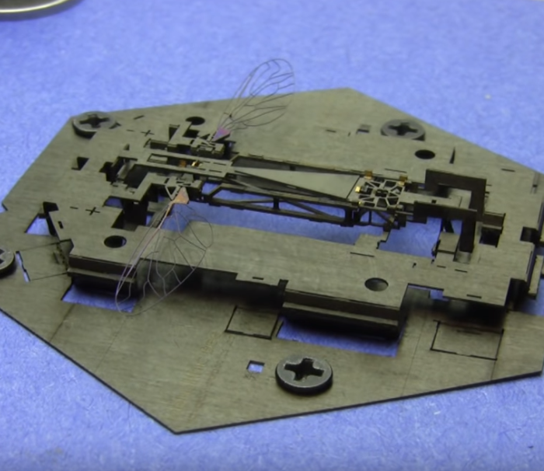
Notes:
Facing the challenge of producing minuscule mechanical devices, designers borrowed techniques from pop-up books, sandwiching sheets of laser-cut materials together into a thin, flat plate that folded up into the complete structure.
Risk-taking mindset
Bring ideas to life
Fail to learn
Start rough and refine
Build with purpose
Source:
ROBOBEE: EXPLODED, 2012
Short URL http://cprhw.tt/o/5xWsr/
Accession Number 2015-23-2
Object ID 51497645

Slide 15
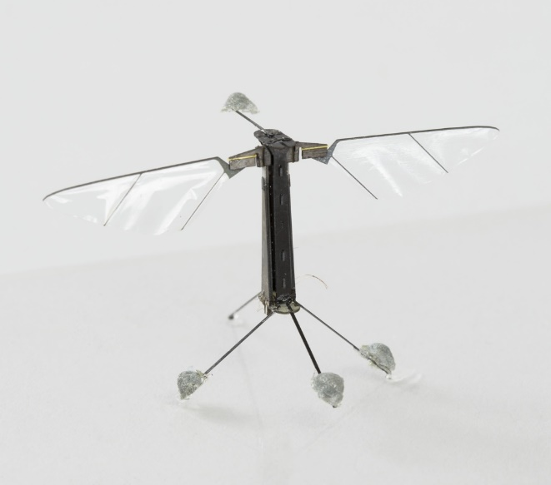
Notes:
With each prototype, designers tested and refined the structure, materials, and programming to improve the flight capabilities and controls, achieving a small and lightweight design that functioned like a bee.
Analytical mindset
Evaluate choices
Establish clear criteria
Inform next steps
Source:
ROBOBEE, 2012
Short URL http://cprhw.tt/o/5xWrv/
Accession Number 2015-23-1
Object ID 51497591

Slide 16
Notes:
Weighing 80 milligrams, approximately the weight of a honeybee, with a wingspan of a little more than 1 inch, the RoboBee is the world’s first insect-scale flying robot. Once fully launched, it may tackle other large challenges in addition to pollinating crops, such as being used for search and rescue missions or monitoring environmental conditions in places humans cannot go safely.
Confident mindset
Share with users
Celebrate successes
Look for improvements
Source:
RoboBees, Wyss Institute
https://wyss.harvard.edu/technology/autonomous-flying-microrobots-robobees/
© 2018 President and Fellows of Harvard College

Slide 17
ACTIVITY: DEFINING THE PROBLEM
Understanding what problem to solve is an important step in the design process.
A solution to a problem or challenge is at the core of a designer’s work.
Using the “Defining the Problem” worksheet, focus on narrowing your problem to something you can solve for in the competition.
Notes:
Let’s begin developing a nature-based design solution to a global problem by framing the challenge.
Designs are often unable to address every aspect of a challenge at once, so they narrow the focus of their challenge to provide clear objectives and manageable outcomes.

Slide 18
WATCH: DEFINING THE PROBLEM
In this video designer Tim Fleschner from Eone talks about the importance of defining the problem.

