Slide 1
2020 NATIONAL HIGH SCHOOL DESIGN COMPETITION LESSON 2: INCLUSIVE DESIGN

Slide 2
WHAT MAKES DESIGN INCLUSIVE?
There are many ways to design inclusivity into products and systems. The following case studies show a range of design solutions, from sportswear to affordable housing to voting booths. What they all have in common is each example creates a more inclusive world.
Soon you will propose your own ideas for how to create a stronger sense of inclusion for all. You can use these examples to guide and shape your methods and your outcome. Remember, design can be an object, a series of objects, a system, or an interface.

Slide 3
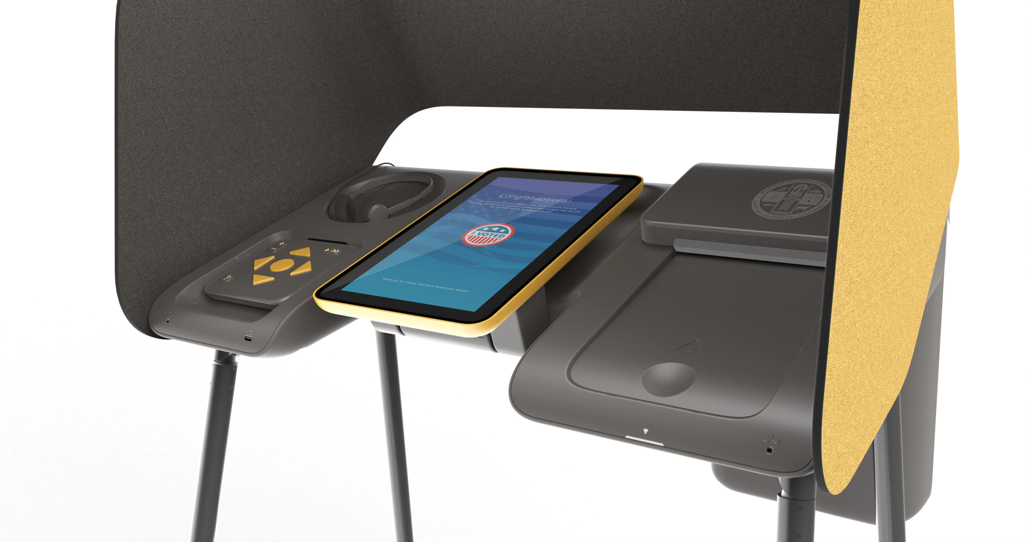
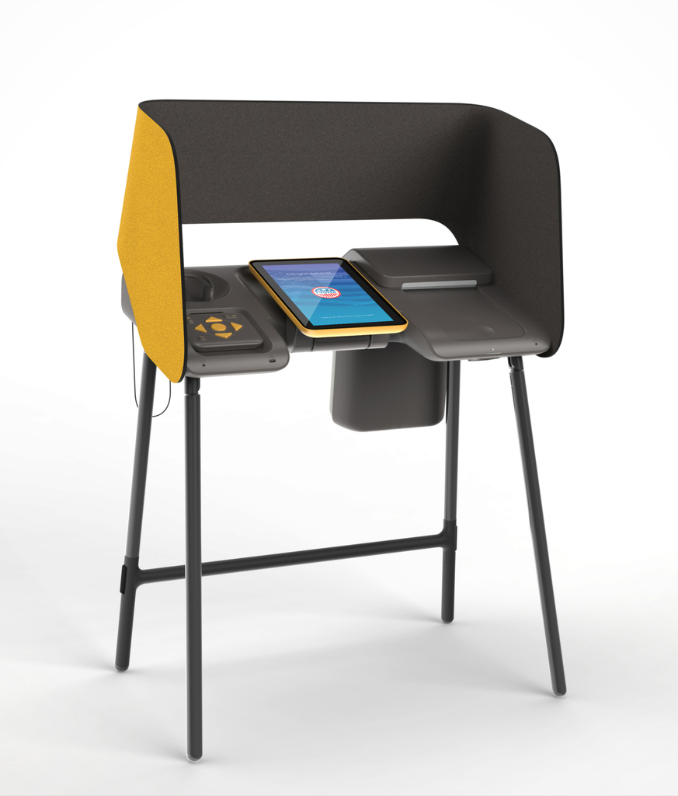
ACCESSIBLE VOTING BOOTH
Notes:
Designed for Los Angeles County as a modular system that can adapt over time, this voting booth exemplifies inclusive design, ensuring every citizen access to an intuitive and accessible voting experience. It addresses all voters, including those unfamiliar with technology and who speak languages other than English, voters with vision and hearing loss, in wheelchairs, and with learning disabilities.
Short URL http://cprhw.tt/o/2Lp8i8/
Accession Number 45.2017.1
Object ID 1158794709

Slide 4
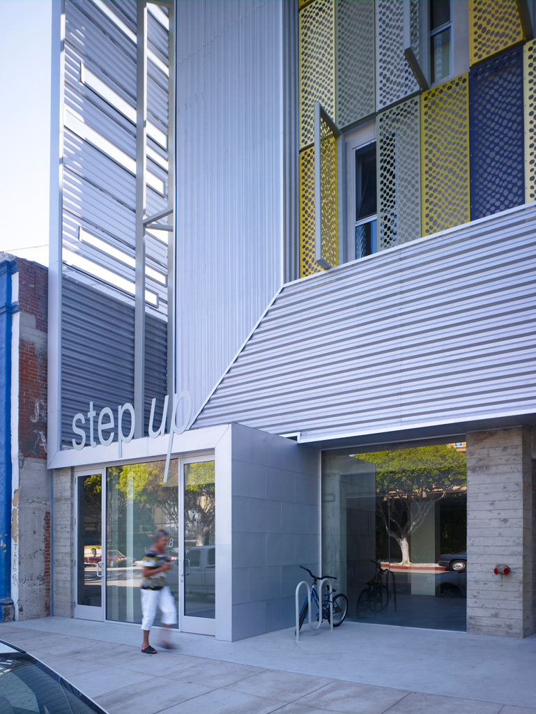
HOUSING FOR ALL
Notes:
These images are of a supportive housing project. It was designed by Brooks + Scarpa, Angela Brooks and Larry Scarpa. It is dated ca. 2009 and Cooper Hewitt acquired it in 2015. Its medium is pen and black ink, color pencil on tracing paper. It is a part of the Drawings, Prints, and Graphic Design department.
Step Up on Fifth, located in the heart of downtown Santa Monica, is a five-story affordable housing complex built to offer support services and rehabilitation for the local homeless and mentally disabled population. Completed in 2009 by Los Angeles-based architecture firm Brooks + Scarpa, the building, a former parking structure, integrates 46 studio apartments with ground-level commercial space.[1] The design utilizes sustainable and recycled materials, including pressed aluminum cans as cladding. During construction, nearly 75 percent of all materials were recycled, while recycled insulation, carpeting and all-natural lineoleum flooring suggest an overall commitment to resource conservation.
Short URL http://cprhw.tt/o/77rnk/
Accession Number 2015-40-1
Object ID 69154985

Slide 5
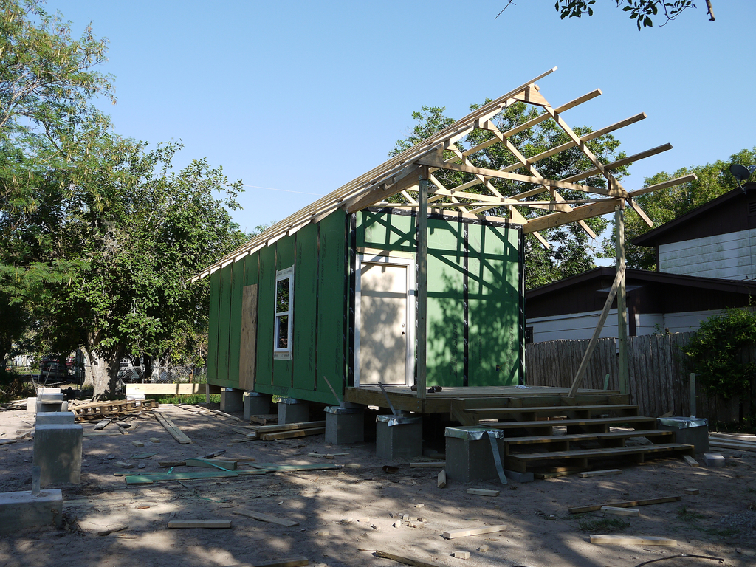
HOUSING FOR ALL
Notes:
This is the Rapido Rapid Recovery Housing project. It was designed by bcWORKSHOP and collaborator: Community Development Corporation of Brownsville, ARISE, La Unión Del Pueblo Entero, Texas A&M University and Texas Low Income Housing Information Service. It is dated 2013–15.
RAPIDO rethinks large-scale rapid housing delivery—especially in vulnerable, low-income neighborhoods—after natural disasters by reducing response time and costs and delivering higher-quality housing while supporting communities. A 400-square-foot core housing unit—containing a living area, kitchen, bathroom, and bedroom—is deployed on a family’s property and local teams help families negotiate the disaster-relief process, while architects and contractors collaborate with families to expand and customize the structure to meet each family’s needs in as few as 90 days at nearly half the typical cost of rehousing.
With climate change and income inequality increasing globally, rapid response housing designs such as this help stabilize communities in the aftermath of environmental disasters such as hurricanes, tornadoes, and fires.
This project was featured in the exhibition By the People: Designing a Better America (September 30, 2016 – February 26, 2017), which explored how design responds to critical social, economic, and climate issues. (URL: https://collection.cooperhewitt.org/exhibitions/404735407/)
Source: https://collection.cooperhewitt.org/objects/420777985/

Slide 6
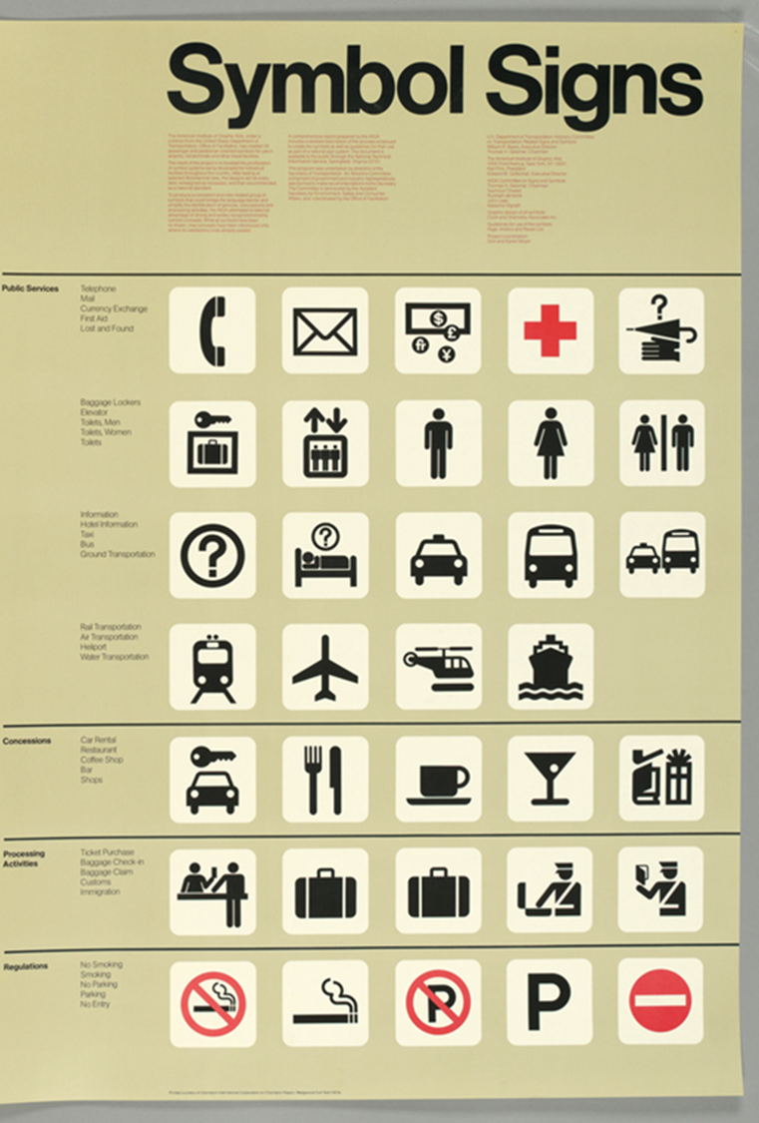
SYMBOLS FOR ALL
Ac
Notes:
In the mid-20th century, graphic designers created a collection of universal non-verbal symbols for use in public spaces such as
airports, libraries, and train stations. This poster, created in 1974, features the symbols that relate to travel. Recently, designers have responded to the growing interest worldwide in increasing inclusivity by acknowledging user groups left out of previous symbol systems. Bathrooms are one of the most common and important public spaces worldwide, and a gender-neutral bathroom symbol is needed.
This poster by Cook & Shanosky Associates, Inc, from 1974 features many of the symbols commonly used in spaces for travel.
Short URL http://cprhw.tt/o/2DGVi/
Accession Number 1997-19-136
Object ID 18673291

Slide 7
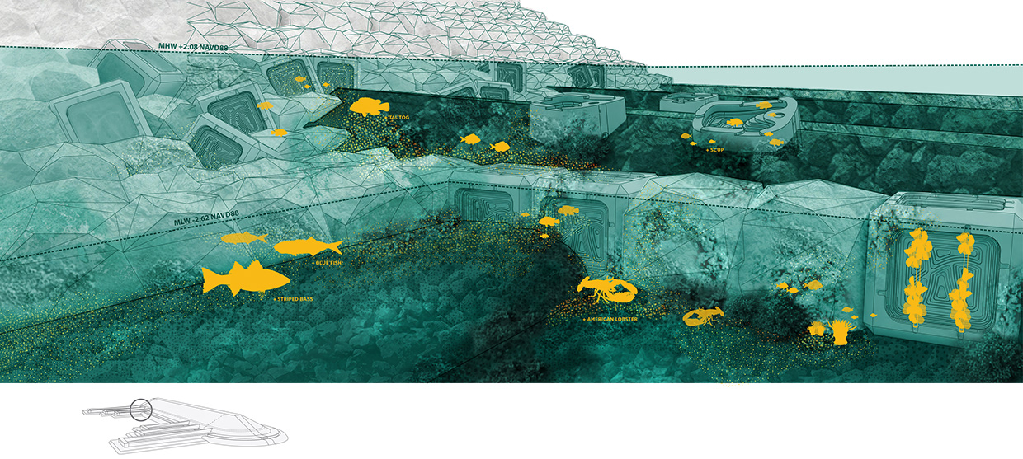
ENVIRONMENTAL EQUITY
Notes:
Landscape architecture firm SCAPE, 2019 National Design Award winners, were selected as one of the winning teams in the Rebuild by Design competition. The project is currently being implemented by the Governor’s Office of Storm Recovery (GOSR) with $60 million of CDBG-DR funding. Planned for the neighborhood of Tottenville, Staten Island, the project links in-water infrastructure with on-shore education and outreach, to help increase awareness of risk, enhance ecologies, and bring local school curriculum to the waterfront. SCAPE was commissioned by the GOSR to lead the schematic design process with a strong coalition of ecological and engineering partners, iteratively testing and designing scenarios for breakwater height, width, and location along the Tottenville shoreline. The team has worked closely with members of the community to create a design that benefits the community while positively affecting regional ecosystems and resiliency efforts. The schematic design process incorporates hydrodynamic and wave modeling, ecological data collection, active community feedback, agency coordination, and constructability assessment. Living Breakwaters is anticipated to move into construction in 2019.
Source: Cooper Hewitt National Design Award Gallery
SCAPE, Living Breakwater Project
URL: http://ndagallery.cooperhewitt.org/gallery/79968367/Living-Breakwaters

Slide 8
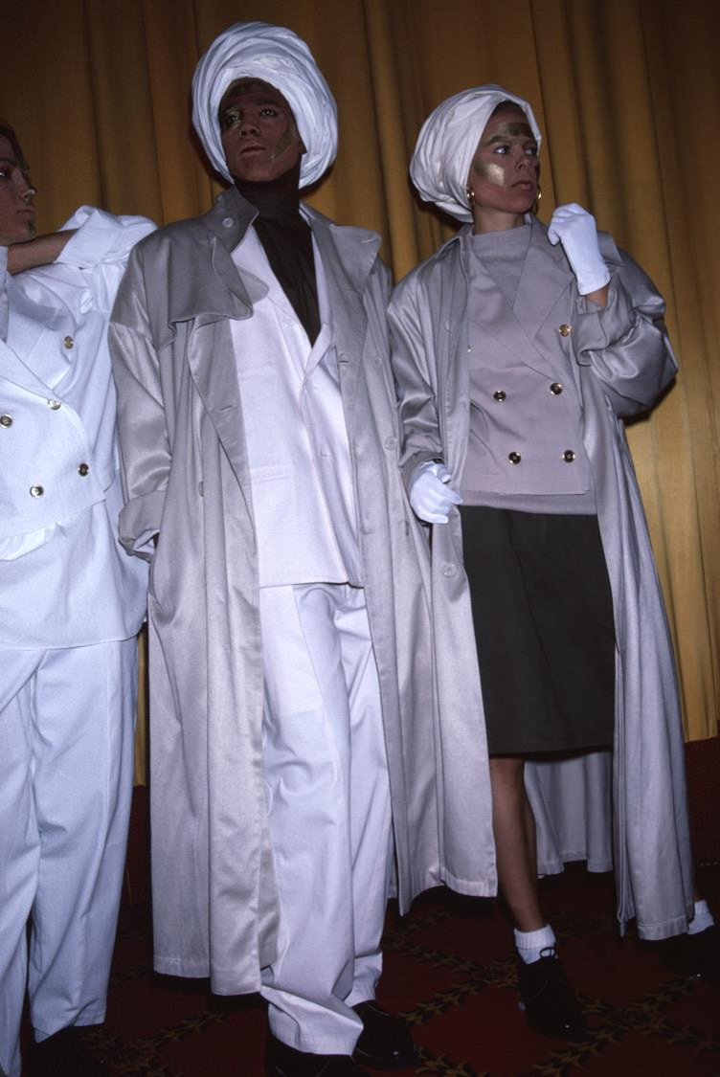
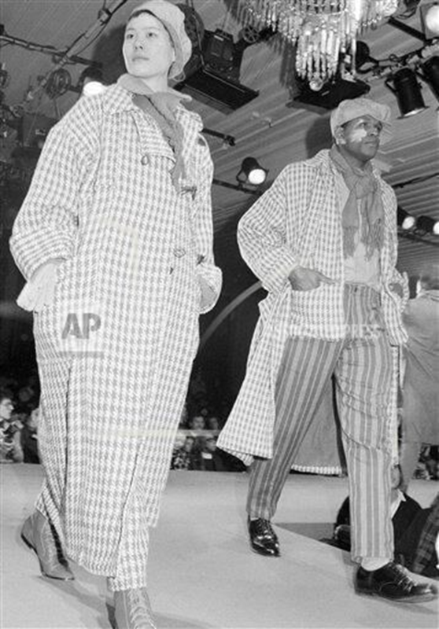
FASHION FOR ALL
Notes:
Fashion designer Willi Smith (1945-1987) was one of the most successful fashion designers of the 1980s, and he remains one of the most influential African American fashion designers of all time. He designed many of his clothes so that they could be worn by all genders, and his fashion shows sometimes featured male and female models wearing the same clothing, as seen in these two images from WilliWear runway shows.
Source: both images from WilliWear: Street Couture, A. Cunningham Cameron, ed. (Rizzoli Electa, 2020)
Willi Smith’s work is explored in the exhibition Willi Smith: Street Couture, opening March 13, 2020 (URL: https://www.cooperhewitt.org/events/current-exhibitions/upcoming-exhibitions/)

Slide 9
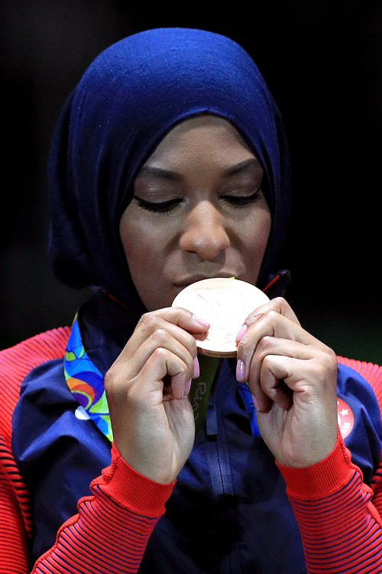
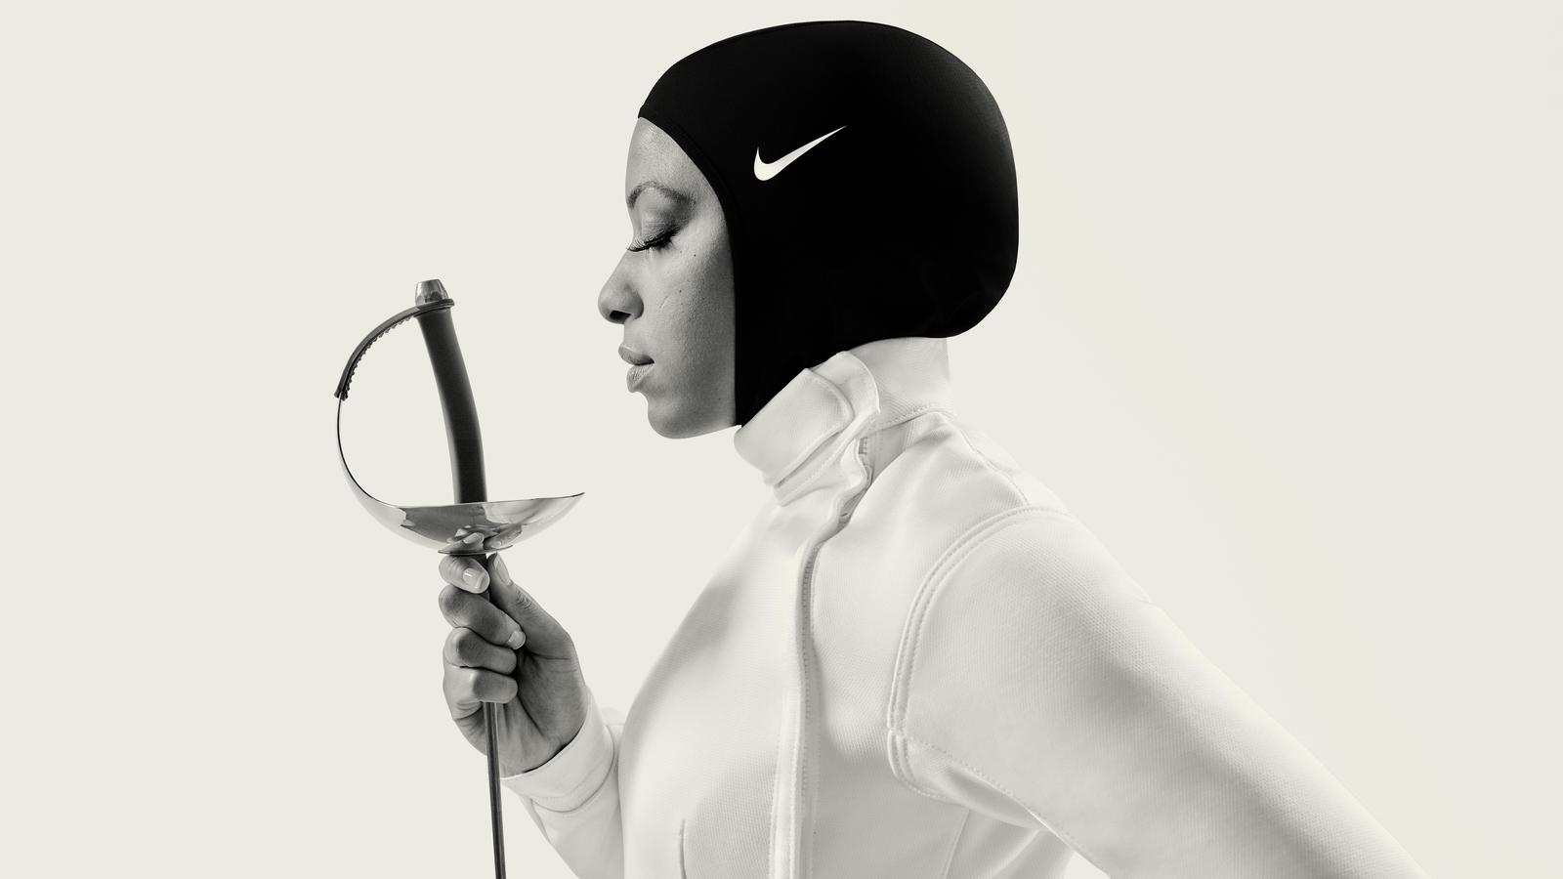
SPORTS FOR ALL
FOR ALL
Notes:
U.S. Olympic fencer Ibtahaj Muhammad is one of the professional athletes who wears the Nike Pro Hijab. She is wearing it in the photo on the left. She is picturedon the right with her bronze medal from the 2016 Olympic Games held in Rio de Janeiro, Brazil. Muhammad has described being athletic as a child and trying many different sports. As a practicing Muslim, she covers her body, including her hair. Before the introduction of athletic hijab (head covering), Muhammad had to wear heavy conventional hijab during practice and competitions.
Source:
Nike Pro hijab, 2014
URL https://collection.cooperhewitt.org/objects/2318797348
Accession Number 2019-10-1

Slide 10
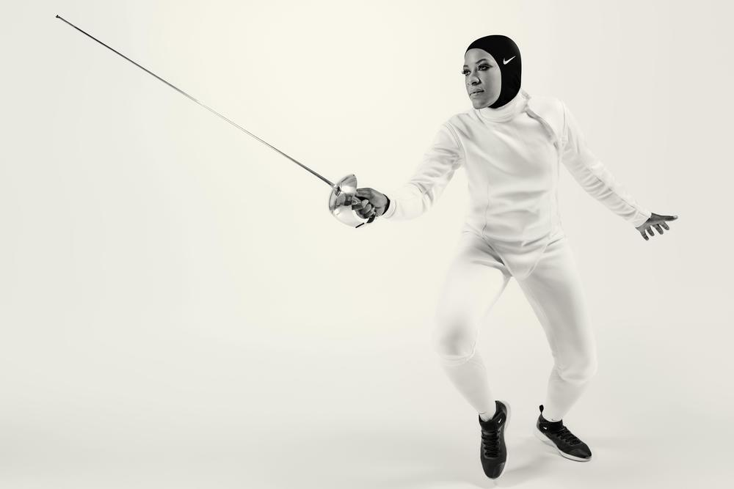
SPORTS FOR ALL
Ibtihaj Muhammad, Olympic Trailblazer: espn.com/video/clip/_/id/18328073
Notes:
In December 2017, Nike became the first global sports brand to enter the modest sportswear market with the release of its Pro Hijab. Designed in collaboration with Muslim athletes from the Middle East, the pull-on covering is made from a breathable lightweight polyester-blend fabric with an elongated back to prevent it from coming untucked during exercise. While Nike was widely celebrated for catering to the needs of Muslim athletes—particularly at a time of heightened racial and religious intolerance worldwide—critics observed that the product was not groundbreaking, as sports hijabs had been designed by small, Muslim-owned companies for decades.
This image features Ibtihaj Muhammad wearing her Nike Pro Hijab. She is one of the global athletes Nike featured in the promotional campaign for the Pro Hijab.
The video on Ibtihaj can be viewed here: www.espn.com/video/clip/_/id/18328073
Image: Nike, Inc.
Short URL http://cprhw.tt/o/4wUrEC/
Accession Number 5.2019.74
Object ID 2318797348

Slide 11
Activity: Design Obstacles
Identify what obstacles you see to inclusion for all.
Learn tactics and methods from some examples of design projects presented here and those you observe elsewhere, and analyze them for opportunities for inclusion. Remember that inclusion can include the design of places, objects, and systems that you identify.
Use the Design Tactics handout and the Design Obstacles Matrix worksheet to begin to analyze what makes us feel included and what makes us feel left out.

