Slide 1
2020 NATIONAL HIGH SCHOOL DESIGN COMPETITION LESSON 1: WHAT IS DESIGN?
Notes:
Using the “What is Design?” presentation to introduce students to the concept of design and explore the design process through a case study, facilitate conversation regarding the ways the steps of the design process support each other and how each step might happen multiple times within a project.

Slide 2
What is design?
Notes:
Ask the class what they think of when you hear the word “design?”

Slide 3
What is design?
Design is all around us.
Design is problem solving.
Design can address big challenges with simple solutions.
Design has a user in mind.
Design can be a system or experience, not just an object.
Design is a process.
Notes:
Design is more than the product or end result; design is the process that creates the end result.

Slide 4
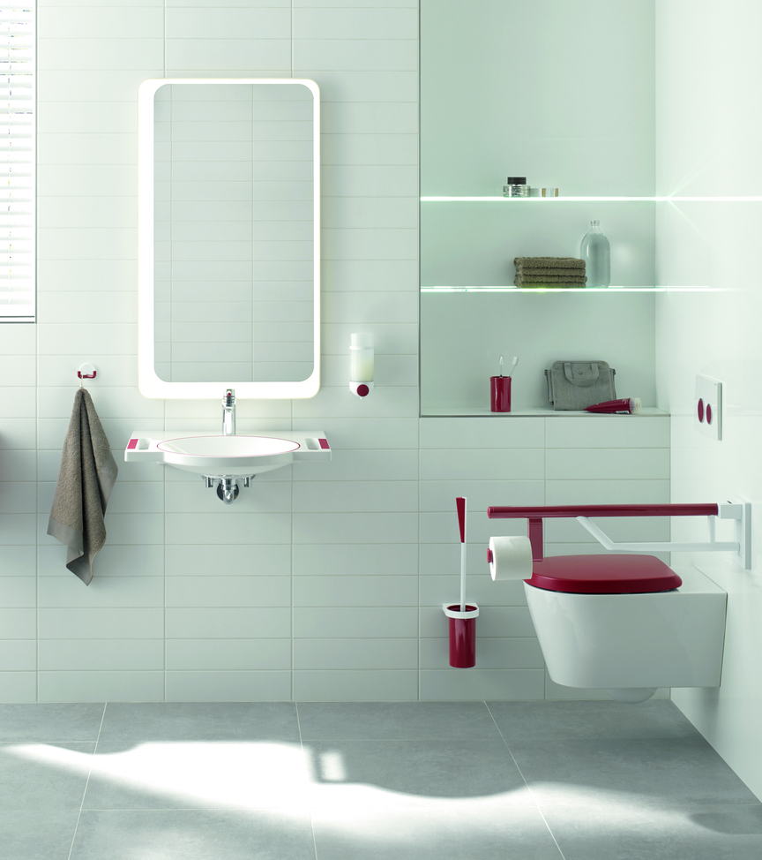
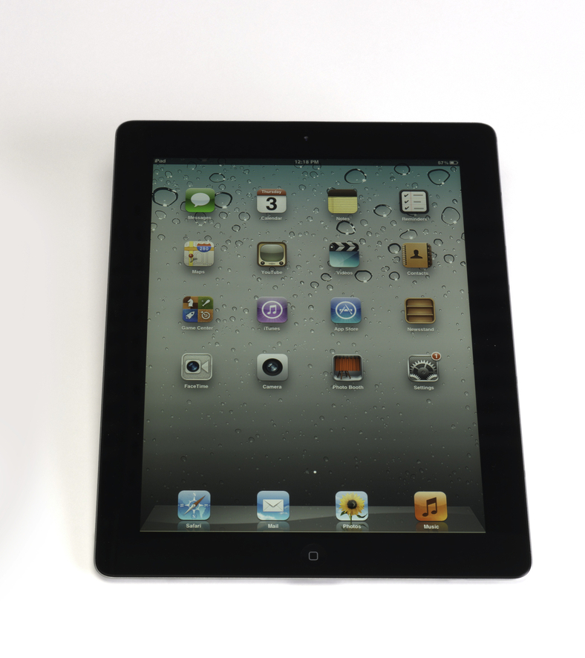
Design is all around us
Notes:
Consider what you’re wearing today, what features does it include? How was it designed to make wearing it more comfortable or functional?
What objects did you use this morning to get ready for school? Consider your toothbrush or toothpaste tube and how they were designed to be efficient or if there are simple ways they could be improved.
Consider all the screens and pieces of technology we utilize each day and how the object has been designed for us to hold and carry. Also think about the icons and interactions that have been designed to make the system easy to use (such as the home button, settings, menus, etc.)
Sources:
JACKET, ADAPTIVE PUFFER JACKET, 2017
https://collection.cooperhewitt.org/objects/1158831757/
0803, HEWI DOOR HARDWARE AND BATHROOM FIXTURES
https://collection.cooperhewitt.org/objects/1159162343/
IPAD 2 TABLET COMPUTER, 2011
https://collection.cooperhewitt.org/objects/18797369/

Slide 5
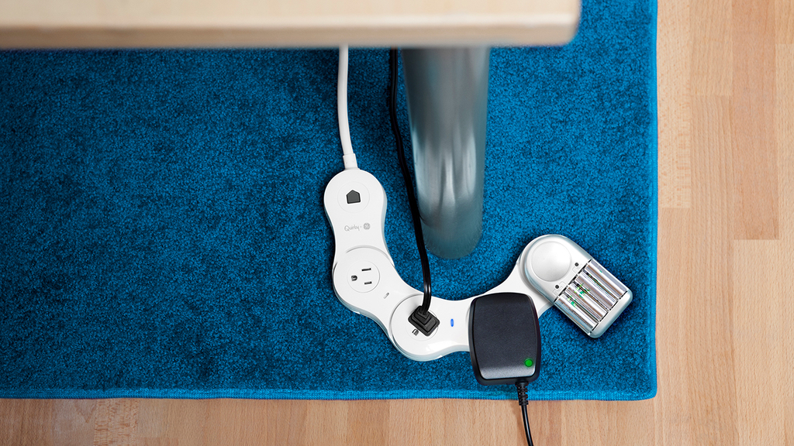
Design is problem solving
Notes:
Design is problem solving, like having a hard time getting an outlet where you need it, or running out of room to plug in your phone. How might we access our outlets more efficiently? Consider challenges that you may have had in finding a place to charge your phone or fitting all of your electronics into your outlet or power strip. These are some of the design solutions that were developed to address these everyday problems.
Sources:
SURGE PROTECTOR, PIVOT POWER GENIUS FLEXIBLE, 2013
https://collection.cooperhewitt.org/objects/68250889/
EXTENSION CORD, PROP POWER WRAP-AROUND, 2013
https://collection.cooperhewitt.org/objects/68775091/

Slide 6
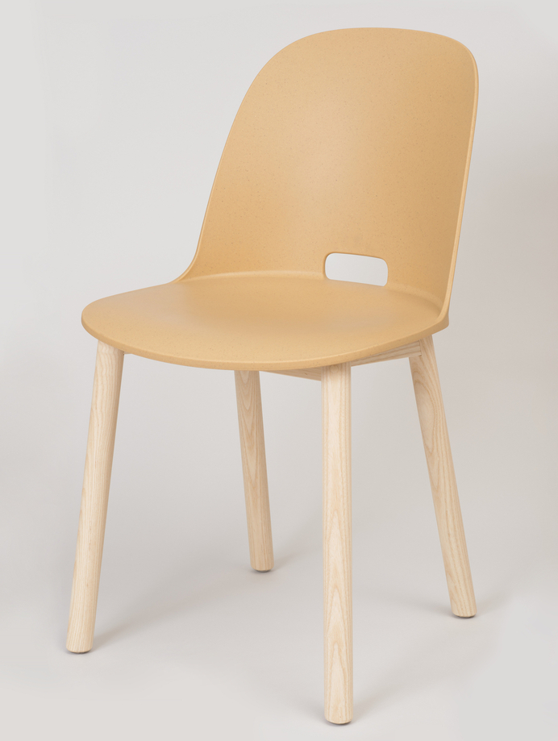
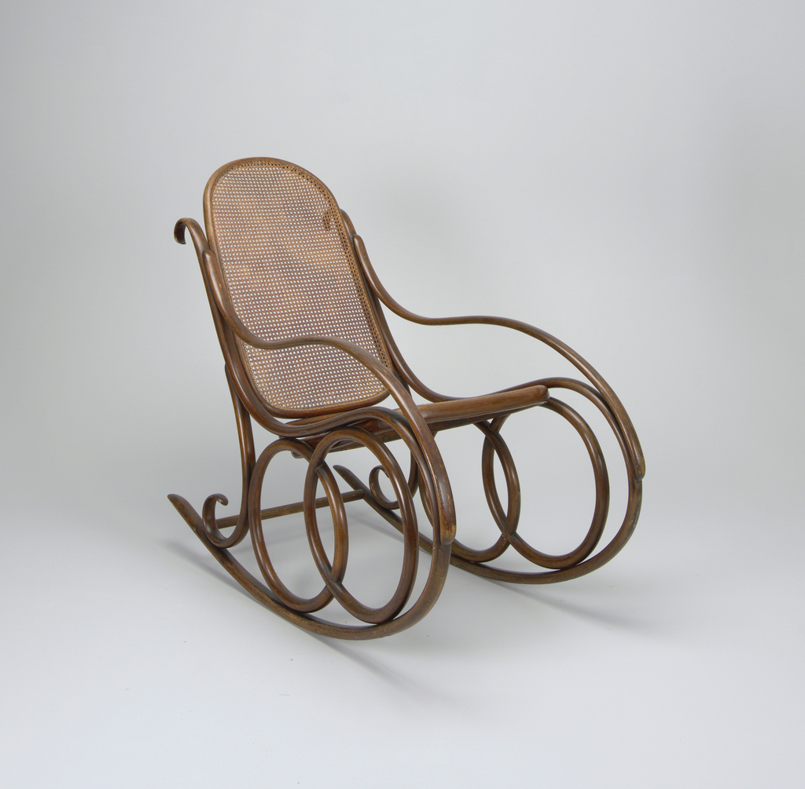
Design has a user in Mind
Notes:
Who might you assume is the intended user or environment for each of these chairs? Even though these objects all have the same function, how is the design different based on the user?
Can you identify a feature or function unique to only one of the designs? What does that feature or function tell you about the intended use or user?
Sources:
AERON OFFICE CHAIR, 1992
https://collection.cooperhewitt.org/objects/18655575/
ALFI HIGH BACK CHAIR, 2015
https://collection.cooperhewitt.org/objects/69187403/
NO. 4 ROCKING CHAIR, CA. 1860
https://collection.cooperhewitt.org/objects/18467803/

Slide 7
Design Can be A system or experience
Or something
In between
Notes:
We may overlook design because we have become so familiar with the experience. Ask students if to identify this object.
While it is a denim jacket, it is made with conductive yarn and can function as an interface, communicating via touch with a variety of networked objects, including smartphones, tablets, and computers. It is both an item of clothing and an interface system.
Short URL http://cprhw.tt/o/2Lp7zX/
Accession Number 5846.1.2017
Object ID 1158792321

Slide 8
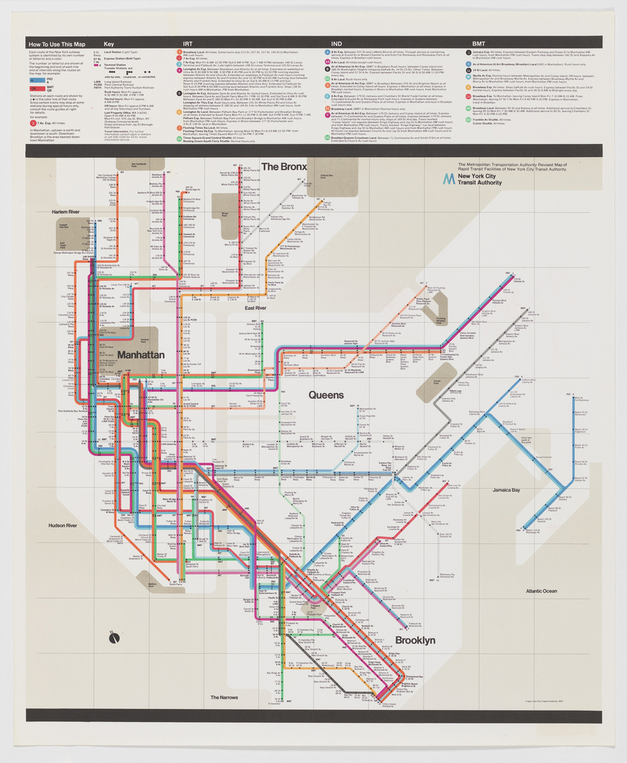
Design can address Big challenges with simple solutions
Notes:
The challenge of navigating a complex system like the New York City subway is just one everyday task made simpler by design. Using a different color for each subway line made the complex subway map easier to navigate and utilize so users could distinguish at a glance where each track would lead them and follow their chosen route. Can students think of other ways color has been utilized to quickly convey information?
Sources:
POSTER, NEW YORK CITY SUBWAY MAP, 1974
https://collection.cooperhewitt.org/objects/18622259/

Slide 9
DESIGN IS A PROCESS
FRAME THE CHALLENGE
BRING IDEAS TO LIFE
SHARE WITH USERS
UNDERSTAND THE CHALLENGE
DIVERGE AND CONVERGE
LEARN AND REFINE
Notes:
The design process can be visualized into several steps. While they are depicted in a linear fashion, the process is often cyclical, returning to the same step multiple times before reaching a satisfactory conclusion.
Each step has a particular function and allows designers to efficiently progress from large challenges to actionable solutions. We will use an example of a project to demonstrate how the design process might look in action.

Slide 10
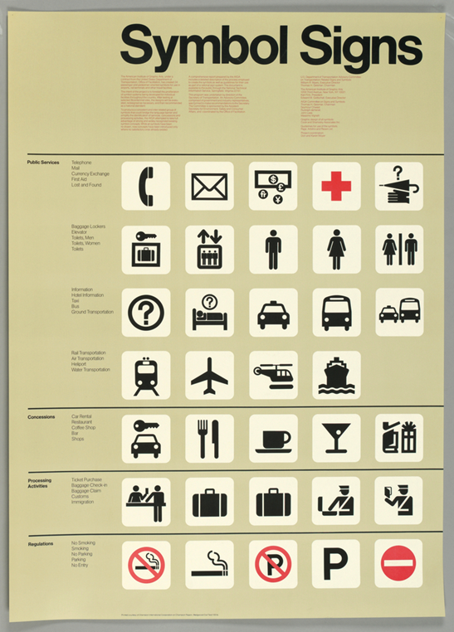
DESIGN CASE STUDY: Bathroom Symbols
Symbol Signs, Cook & Shanosky Associates, 1974
Notes:
Objectives:
Gain familiarity with the design process
Understand what the steps of the design process might look like in application
Connect design objects to the design process

Slide 11
Notes:
In the mid-20th century, graphic designers created a collection of universal non-verbal symbols for use in public spaces such as airports, libraries, and train stations. These symbols are still in constant use, but the male and female figures do not acknowledge all, and designers all over the world are working to create a more inclusive symbolic language.
Strategic mindset
Identify the problem
Frame the problem
Adjust scope
Identify stakeholders
Source:
AIGA Symbol Signs (www.aiga.org/symbol-signs)

Slide 12
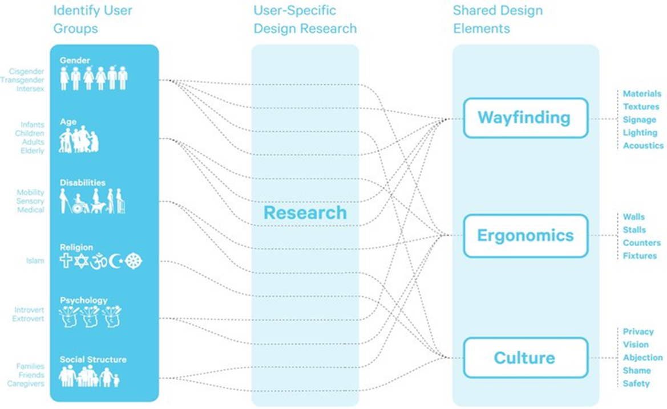
Notes:
Recently, designers have responded to the growing interest worldwide in increasing inclusivity by acknowledging user groups left out of previous symbol systems. Bathrooms are one of the most common and important public spaces worldwide, and a gender-neutral bathroom symbol is needed. This user identity diagram, developed as part of Stalled.Online’s all gender bathroom design research, maps some of the many user considerations necessary to inclusive bathroom design.
Inquisitive mindset
Understand the user
Learn from all stakeholders
Map different viewpoints
Challenge assumptions
Source: Stalled.online (www.stalled.online)

Slide 13
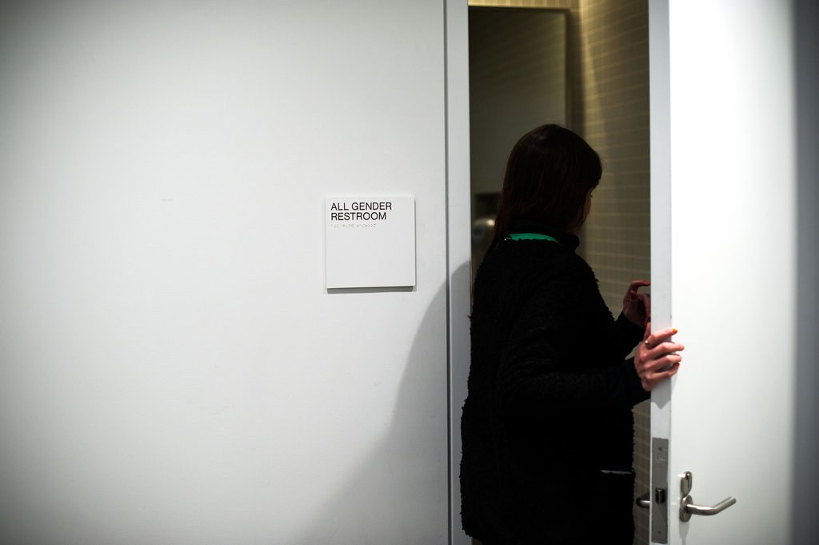
Notes:
Many designers and users have brainstormed diverse proposals to solve the problem of an inclusive, gender neutral bathroom symbol. This restroom sign at the Whitney Museum in New York City has no symbols, and uses English language (including Braille) to communicate.
Prolific mindset
Defer judgement and encourage wild ideas
Record all ideas and be visual
Stay on topic and build on the ideas of others
Strive for quantity
Source: https://www.nytimes.com/2015/11/08/style/transgender-restroom-all-gender.html

Slide 14
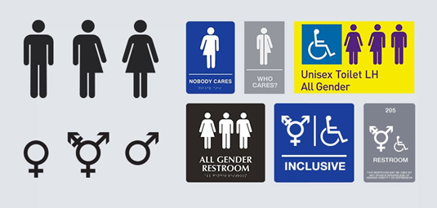
Notes:
Facing the challenge of producing minuscule mechanical devices, designers borrowed techniques from pop-up books, sandwiching sheets of laser-cut materials together into a thin, flat plate that folded up into the complete structure.
Risk-taking mindset
Bring ideas to life
Fail to learn
Start rough and refine
Build with purpose
Source:
Gaul, Chris. “We're Missing a Universal Restroom Symbol, and Here's Why It Matters.” Medium, Medium, 24 June 2019, medium.com/@chrisgaul/a-design-for-a-universal-restroom-symbol-bc5f9fd120b6

Slide 15
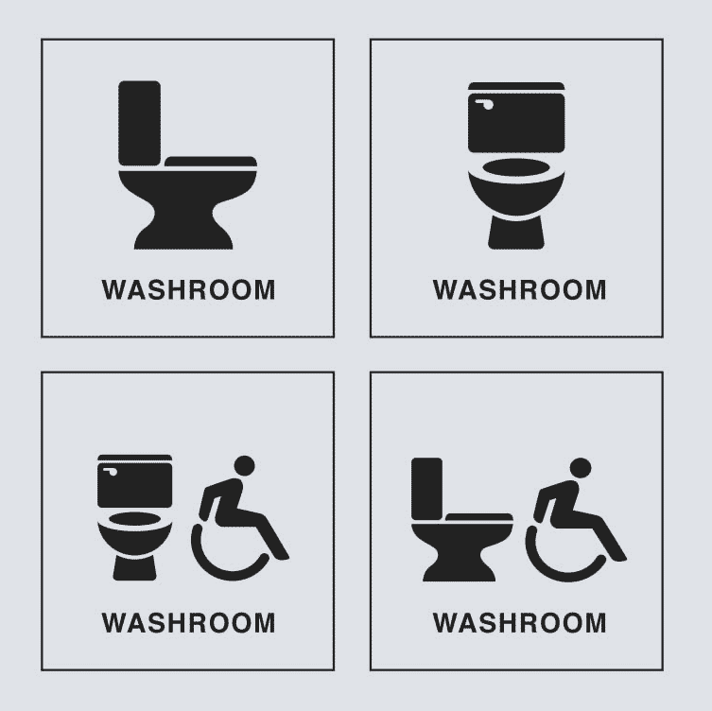
Notes:
With each prototype, designers tested and refined the structure, materials, and programming to improve the flight capabilities and controls, achieving a small and lightweight design that functioned like a bee. With each prototype, designers test and refine their icons in order to make them instantly recognizable and inclusive. A challenge has been to find symbols that can communicate cross-culturally. For example, the toilet symbol does not reflect the shape or structure of all toilets around the world, and communicates clearly to some users and not at all to others.
Analytical mindset
Evaluate choices
Establish clear criteria
Inform next steps
Source: Restroom symbols for signage in healthcare facilities (Designed for the Canadian Standards Association by Entro), in Gaul, Chris. “We're Missing a Universal Restroom Symbol, and Here's Why It Matters.” Medium, Medium, 24 June 2019, medium.com/@chrisgaul/a-design-for-a-universal-restroom-symbol-bc5f9fd120b6

Slide 16
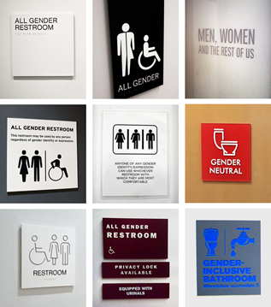
Notes:
While there is no universal symbol representing all-gender bathrooms, many places are currently using verbal and non-verbal signs to indicate all-gender inclusivity. Can you think of any solutions to this obstacle to inclusion?
Confident mindset
Share with users
Celebrate successes
Look for improvements
Source:
Ball, Aimee Lee. “In All-Gender Restrooms, the Signs Reflect the Times.” The New York Times, The New York Times, 5 Nov. 2015, www.nytimes.com/2015/11/08/- style/transgender-restroom-all-gender.html

Slide 17
ACTIVITY: DEFINING THE PROBLEM
Understanding what problem to solve is an important step in the design process.
A solution to an obstacle or challenge is at the core of a designer’s work.
Using the Mapping Inclusion worksheet, focus on narrowing your problem to something you can solve for in the competition.
Notes:
Designs are often unable to address every aspect of a challenge at once, so they narrow the focus of their challenge to provide clear objectives and manageable outcomes.

Slide 18
WATCH: DEFINING THE PROBLEM
In this video designer Tim Fleschner from Eone talks about the importance of defining the problem.
Notes:
The video will auto play on the next slide. If it does not, scroll over the slide to see the video control to play the video manually.

Slide 19
Notes:
The video will auto play. If it does not, scroll over the slide to see the video control to play the video manually.

